Slide 1
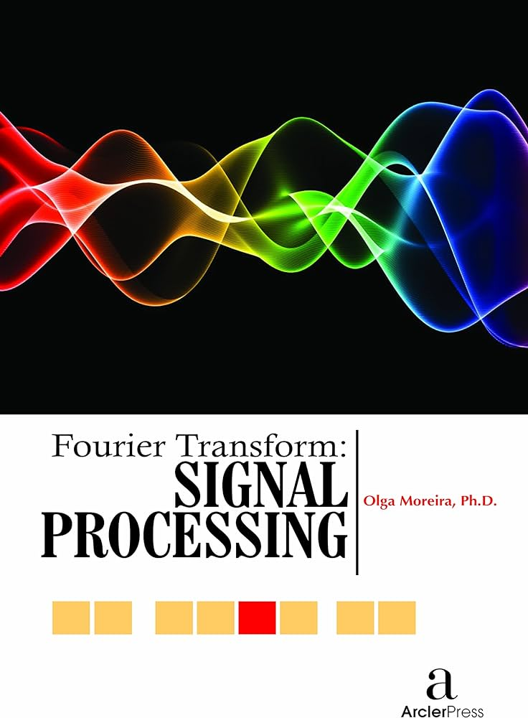
Name: Ugwu Emmanuel Ugochukwu Student I.D: SL23215017 Major: Computer Technology University: University of Science and Technology of China
Research Report on the Application of Fourier Transforms in the Past 3 Years
Notes:
1. Table of contents
2. Introduction
3. Quote
4. Study objectives
5. Literature review
6. Schedule
7. Methodology
8. Table
9. Results analysis
10. Conclusions
11. Bibliographical references

Slide 2
Table of contents
01
03
02
04
Introduction
Conclusion
Introduce Fourier transform
Conclude with a summary
Application
Future Direction
Discuss the application of Fourier transform
State a few future directions of the papers
05
References
References

Slide 3

01
Introduction

Slide 4
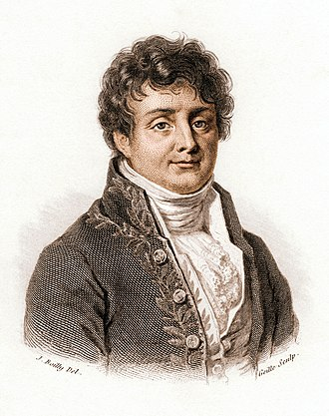
Introduction
What’s Fourier transform?
A mathematical operation that decomposes a function into its constituent frequencies [1]. Introduced by Jean-Baptiste Fourier in 1807 [1, 2].
Jean-Baptiste Fourier
https://en.wikipedia.org/wiki/Joseph_Fourier [3]

Slide 5
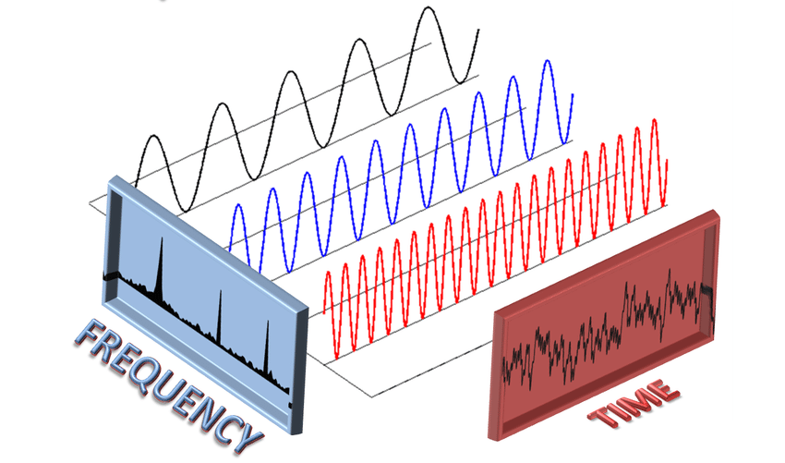
Introduction
What does it look like?
An audio signal consisting of three different signals with individual frequencies.
https://www.researchgate.net/figure/Fast-Fourier-Transformation-2-Fast-Fourier-Transformation-To-increase-the-performance_fig6_323281289 [4]

Slide 6
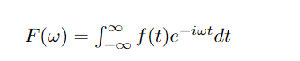
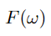
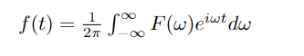
Introduction
What does it look like?
The Fourier transform of a signal is defined as:
(1)
Where is the angular frequency.
The inverse Fourier transform of a signal is defined as:
(2)
https://www.mathsisfun.com/calculus/fourier-series.html [5]

Slide 7
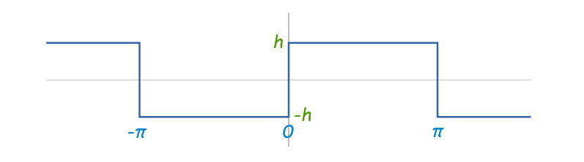
Introduction
What does it look like?
Signal we would like to attain
https://www.mathsisfun.com/calculus/fourier-series.html [5]

Slide 8
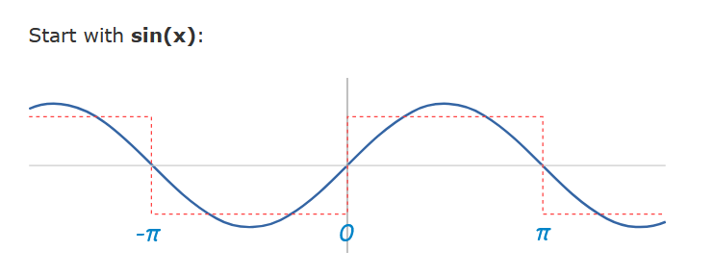
Introduction
What does it look like?
https://www.mathsisfun.com/calculus/fourier-series.html [5]

Slide 9
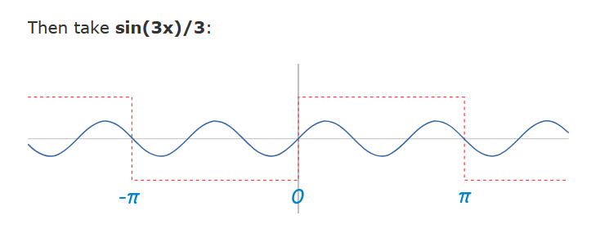
Introduction
What does it look like?
https://www.mathsisfun.com/calculus/fourier-series.html [5]

Slide 10
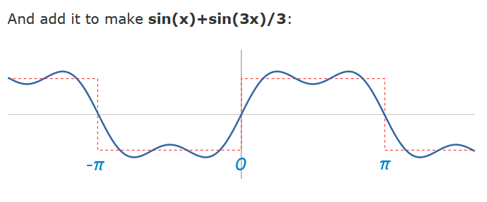
Introduction
What does it look like?
https://www.mathsisfun.com/calculus/fourier-series.html [5]

Slide 11
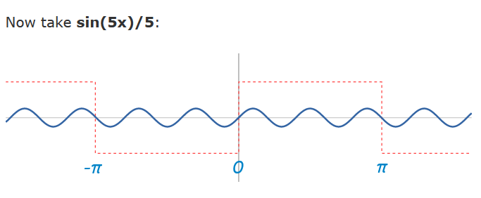
Introduction
What does it look like?
https://www.mathsisfun.com/calculus/fourier-series.html [5]

Slide 12
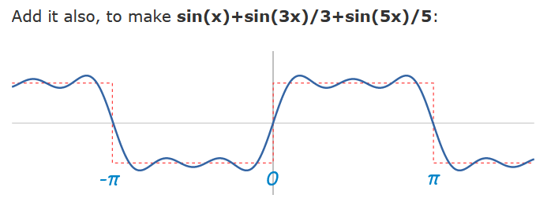
Introduction
What does it look like?
https://www.mathsisfun.com/calculus/fourier-series.html [5]

Slide 13
Introduction
What does it look like?
More sine waves
https://www.mathsisfun.com/calculus/fourier-series.html [5]

Slide 14
Introduction
What does it look like?
More sine waves
https://www.mathsisfun.com/calculus/fourier-series.html [5]

Slide 15
Introduction
What does it look like?
A square wave = sin (x) + sin (3x)/3 + sin (5x)/5 + ... (infinitely) (3)
https://www.mathsisfun.com/calculus/fourier-series.html [5]

Slide 16
If you want to find the secrets of the universe, think in terms of energy, frequency, and vibration.
—Nikola Tesla
https://www.reddit.com/r/QuotesPorn/comments/oy6qf2/if_you_want_to_find_the_secrets_of_the_universe/?rdt=37958[] [4]
[6]

Slide 17
Introduction
Study objectives
To discuss the application of the Fourier transform in different areas by reviewing papers from the past three years to highlight the latest advances in Fourier transform applications.

Slide 18
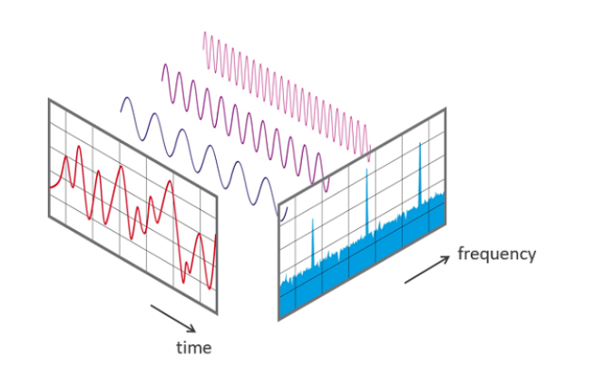
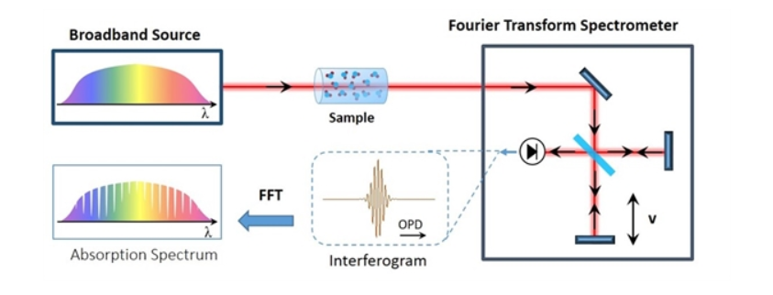
Introduction
Uses of Fourier transform?
https://medium.com/crossml/fourier-transformation-in-image-processing-84142263d734 [7]
https://www.nti-audio.com/en/support/know-how/fast-fourier-transform-fft [8]
https://www.ru.nl/tdlab/research/laser_spectroscopy/fourier-transform-spectrometer-fts/ [9]
Image processing
Audio processing
Spectroscopy
Filter, compress, and denoise images or feature detection like edges and corners [5]
To analyze the frequency spectrum of light and so on[7]
Filter, compress, and denoise audio signals and also feature identification like pitch and timbre [6]

Slide 19
02
Applications

Slide 20
Papers
Paper 1
Paper 2
Paper 3
A review on Sparse Fast Fourier Transform application in Image Processing [10]
Fourier analysis using the number of COVID-19 daily deaths in the US [11]
Recognizing human actions with multiple Fourier transforms [12]
Paper 4
Paper 5
Optimizing Fast Fourier Transform (FFT) Image Compression using Intelligent Water Drop (IWD) Algorithm [13]
Discrete Fourier Transform (DFT)-Based Computational Intelligence Model for Urban Carbon Emission and Economic Growth [14]

Slide 21
Paper 1
Introduction
Method
Application
Key-findings
Advantages and Disadvantages

Slide 22
Paper 1
Introduction
Method
Application
Key-findings
Advantages and Disadvantages

Slide 23
Paper 1
Introduction
A review on Sparse Fast Fourier Transform application in Image Processing [10]
In this section, we delve into the world of Sparse Fast Fourier Transform (sFFT) as a powerful solution in image processing.

Slide 24
Paper 1
Method
A review on Sparse Fast Fourier Transform application in Image Processing
Sparse Fast Fourier Transform (sFFT) is a technique that optimizes the computation of the Fast Fourier Transform (FFT) for signals with sparse frequency domain representations. Here's a brief explanation of how sFFT works:

Slide 25
Paper 1
Method
A review on Sparse Fast Fourier Transform application in Image Processing
Sparse Fast Fourier Transform (sFFT) is a technique that optimizes the computation of the Fast Fourier Transform (FFT) for signals with sparse frequency domain representations. Here's a brief explanation of how sFFT works:
Sparse Signals: sFFT is designed to handle signals where the frequency domain representation is sparse, meaning that only a few frequencies have significant amplitudes, while the majority are close to zero.

Slide 26
Paper 1
Method
A review on Sparse Fast Fourier Transform application in Image Processing
Sparse Fast Fourier Transform (sFFT) is a technique that optimizes the computation of the Fast Fourier Transform (FFT) for signals with sparse frequency domain representations. Here's a brief explanation of how sFFT works:
Sparse Signals: sFFT is designed to handle signals where the frequency domain representation is sparse, meaning that only a few frequencies have significant amplitudes, while the majority are close to zero.
Coefficient Selection: Rather than performing a full FFT on the entire signal, sFFT strategically selects a subset of coefficients in the frequency domain that are most likely to contain significant information. These coefficients correspond to the non-zero frequencies in the sparse signal.

Slide 27
Paper 1
Method
A review on Sparse Fast Fourier Transform application in Image Processing
Sparse Fast Fourier Transform (sFFT) is a technique that optimizes the computation of the Fast Fourier Transform (FFT) for signals with sparse frequency domain representations. Here's a brief explanation of how sFFT works:
Sparse Signals: sFFT is designed to handle signals where the frequency domain representation is sparse, meaning that only a few frequencies have significant amplitudes, while the majority are close to zero.
Coefficient Selection: Rather than performing a full FFT on the entire signal, sFFT strategically selects a subset of coefficients in the frequency domain that are most likely to contain significant information. These coefficients correspond to the non-zero frequencies in the sparse signal.
Efficient Computation: sFFT computes only the selected coefficients, significantly reducing the computational load compared to a full FFT. This efficiency is particularly valuable for high-dimensional signals like images.

Slide 28
Paper 1
Method
A review on Sparse Fast Fourier Transform application in Image Processing
Sparse Fast Fourier Transform (sFFT) is a technique that optimizes the computation of the Fast Fourier Transform (FFT) for signals with sparse frequency domain representations. Here's a brief explanation of how sFFT works:
Sparse Signals: sFFT is designed to handle signals where the frequency domain representation is sparse, meaning that only a few frequencies have significant amplitudes, while the majority are close to zero.
Coefficient Selection: Rather than performing a full FFT on the entire signal, sFFT strategically selects a subset of coefficients in the frequency domain that are most likely to contain significant information. These coefficients correspond to the non-zero frequencies in the sparse signal.
Efficient Computation: sFFT computes only the selected coefficients, significantly reducing the computational load compared to a full FFT. This efficiency is particularly valuable for high-dimensional signals like images.
Reconstruction: After obtaining the selected coefficients, sFFT can reconstruct the original signal accurately. The result is a transformed signal in the frequency domain with a much smaller set of non-zero coefficients.

Slide 29
Paper 1
Method
A review on Sparse Fast Fourier Transform application in Image Processing
Sparse Fast Fourier Transform (sFFT) is a technique that optimizes the computation of the Fast Fourier Transform (FFT) for signals with sparse frequency domain representations. Here's a brief explanation of how sFFT works:
Sparse Signals: sFFT is designed to handle signals where the frequency domain representation is sparse, meaning that only a few frequencies have significant amplitudes, while the majority are close to zero.
Coefficient Selection: Rather than performing a full FFT on the entire signal, sFFT strategically selects a subset of coefficients in the frequency domain that are most likely to contain significant information. These coefficients correspond to the non-zero frequencies in the sparse signal.
Efficient Computation: sFFT computes only the selected coefficients, significantly reducing the computational load compared to a full FFT. This efficiency is particularly valuable for high-dimensional signals like images.
Reconstruction: After obtaining the selected coefficients, sFFT can reconstruct the original signal accurately. The result is a transformed signal in the frequency domain with a much smaller set of non-zero coefficients.
Applications: sFFT is particularly useful in various applications where signals have sparse frequency representations, such as image processing, audio compression, and sparse data analysis.

Slide 30
Paper 1
Application
A review on Sparse Fast Fourier Transform application in Image Processing
Optimization of Lithography Source Illumination, where it enhances image quality and minimizes computational complexity for integrated circuits.

Slide 31
Paper 1
Application
A review on Sparse Fast Fourier Transform application in Image Processing
Optimization of Lithography Source Illumination, where it enhances image quality and minimizes computational complexity for integrated circuits.
Image Evolution and Perceived Characteristics Measurement, enabling better image enhancements in procedural image generation.

Slide 32
Paper 1
Application
A review on Sparse Fast Fourier Transform application in Image Processing
Optimization of Lithography Source Illumination, where it enhances image quality and minimizes computational complexity for integrated circuits.
Image Evolution and Perceived Characteristics Measurement, enabling better image enhancements in procedural image generation.
Radar Signal Processing, aiding in real-time position calculations for radar systems, particularly in short-range ubiquitous radar.

Slide 33
Paper 1
Application
A review on Sparse Fast Fourier Transform application in Image Processing
Optimization of Lithography Source Illumination, where it enhances image quality and minimizes computational complexity for integrated circuits.
Image Evolution and Perceived Characteristics Measurement, enabling better image enhancements in procedural image generation.
Radar Signal Processing, aiding in real-time position calculations for radar systems, particularly in short-range ubiquitous radar.
Fast Nonlinear Compressive Sensing Lithographic Source, contributing to chip-level source and mask optimization while reducing computational load.

Slide 34
Paper 1
Application
A review on Sparse Fast Fourier Transform application in Image Processing
Optimization of Lithography Source Illumination, where it enhances image quality and minimizes computational complexity for integrated circuits.
Image Evolution and Perceived Characteristics Measurement, enabling better image enhancements in procedural image generation.
Radar Signal Processing, aiding in real-time position calculations for radar systems, particularly in short-range ubiquitous radar.
Fast Nonlinear Compressive Sensing Lithographic Source, contributing to chip-level source and mask optimization while reducing computational load.
Identification of Microplastics in Wastewater Treatment, where it measures microplastic pollution intensity using focal plane array FT, thus improving accuracy and speed in wastewater treatment.

Slide 35
Paper 1
Application
A review on Sparse Fast Fourier Transform application in Image Processing
Optimization of Lithography Source Illumination, where it enhances image quality and minimizes computational complexity for integrated circuits.
Image Evolution and Perceived Characteristics Measurement, enabling better image enhancements in procedural image generation.
Radar Signal Processing, aiding in real-time position calculations for radar systems, particularly in short-range ubiquitous radar.
Fast Nonlinear Compressive Sensing Lithographic Source, contributing to chip-level source and mask optimization while reducing computational load.
Identification of Microplastics in Wastewater Treatment, where it measures microplastic pollution intensity using focal plane array FT, thus improving accuracy and speed in wastewater treatment.
Cancer Detection, employing Fourier Transform Infrared spectroscopy for early cancer detection, distinguishing between healthy and malignant tissues based on molecular-level vibrational analysis.

Slide 36
Paper 1
Key-Findings
A review on Sparse Fast Fourier Transform application in Image Processing
Sparse Fourier Transform is useful in reducing the required computational complexity especially when the signals to be represented are sparse.

Slide 37
Paper 1
Advantages
A review on Sparse Fast Fourier Transform application in Image Processing
The applications of sFFT itself can be considered its advantages as it significantly benefits various areas such as Optimization of Lithography Source Illumination, Image Evolution and Perceived Characteristics Measurement, Radar Signal Processing, Fast Nonlinear Compressive Sensing Lithographic Source, Identification of Microplastics in Wastewater Treatment, and Cancer Detection.

Slide 38
Paper 1
Disadvantages
A review on Sparse Fast Fourier Transform application in Image Processing
However, it's important to note that while sFFT offers significant advantages, there are potential challenges and limitations, including managing larger bandwidth and computational complexity as demands for higher-dimensional signals increase.

Slide 39
Paper 2
Introduction
Method
Application
Key-findings
Advantages and Disadvantages

Slide 40
Paper 2
Introduction
Method
Application
Key-findings
Advantages and Disadvantages

Slide 41
Paper 2
Introduction
Fourier analysis using the number of COVID-19 daily deaths in the US [11]
In 2021, Yoshiyasu Takefuji's groundbreaking paper delves into the world of Fourier analysis to monitor and understand the dynamics of the COVID-19 pandemic in the United States

Slide 42
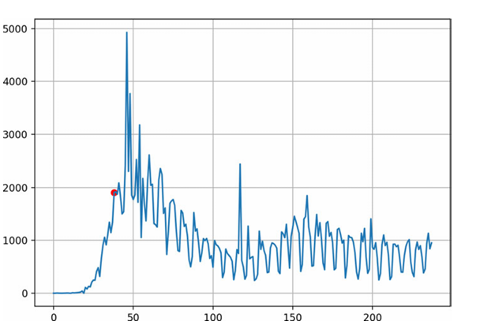
Paper 2
Method
Fourier analysis using the number of COVID-19 daily deaths in the US
This paper introduces a Fourier analysis approach for examining the cycle length and the power spectrum of the COVID-19 pandemic by converting the number of daily deaths into the frequency domain
Number of daily deaths in the US from 1 March 2019 to 24 October 2020. X-axis: days, Y-axis: the number of daily deaths, red point indicating 8 April [11].

Slide 43
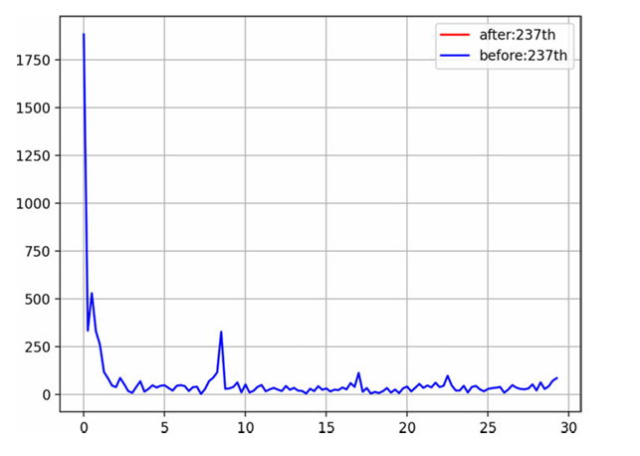
Paper 2
Method
Fourier analysis using the number of COVID-19 daily deaths in the US
This paper introduces a Fourier analysis approach for examining the cycle length and the power spectrum of the COVID-19 pandemic by converting the number of daily deaths into the frequency domain
Result of spectrum analysis using FFT. X-axis: the cycle of days, Y-axis: the power spectrum [9].

Slide 44
Paper 2
Method
Fourier analysis using the number of COVID-19 daily deaths in the US
daily deaths to frequency domain
Number of daily deaths in the US from 1 March 2019 to 24 October 2020. X-axis: days, Y-axis: the number of daily deaths, red point indicating 8 April [11].
Result of spectrum analysis using FFT. X-axis: the cycle of days, Y-axis: the power spectrum [11].

Slide 45
Paper 2
Application
Fourier analysis using the number of COVID-19 daily deaths in the US
This paper introduces a Fourier analysis approach for examining the cycle length and the power spectrum of the COVID-19 pandemic by converting the number of daily deaths into the frequency domain

Slide 46
Paper 2
Key-Findings
Fourier analysis using the number of COVID-19 daily deaths in the US
The study presents a unique perspective by focusing on cycle length (one month) in the power spectrum, providing valuable insights into the pandemic's behavior (frequency of deaths during said period).

Slide 47
Paper 2
Key-Findings
Fourier analysis using the number of COVID-19 daily deaths in the US
The study presents a unique perspective by focusing on cycle length (one month) in the power spectrum, providing valuable insights into the pandemic's behavior (frequency of deaths during said period).
By applying the Fast Fourier Transform (FFT) to daily death data recorded from March 1, 2020, to October 24, 2020, the researchers could identify recurring cycles within the pandemic.

Slide 48
Paper 2
Key-Findings
Fourier analysis using the number of COVID-19 daily deaths in the US
The study presents a unique perspective by focusing on cycle length (one month) in the power spectrum, providing valuable insights into the pandemic's behavior (frequency of deaths during said period).
By applying the Fast Fourier Transform (FFT) to daily death data recorded from March 1, 2020, to October 24, 2020, the researchers could identify recurring cycles within the pandemic.
Shorter cycles correspond to pandemic resurgence, while longer cycles indicate a decline.

Slide 49
Paper 2
Key-Findings
Fourier analysis using the number of COVID-19 daily deaths in the US
The study presents a unique perspective by focusing on cycle length (one month) in the power spectrum, providing valuable insights into the pandemic's behavior (frequency of deaths during said period).
By applying the Fast Fourier Transform (FFT) to daily death data recorded from March 1, 2020, to October 24, 2020, the researchers could identify recurring cycles within the pandemic.
Shorter cycles correspond to pandemic resurgence, while longer cycles indicate a decline.
This approach equips policymakers with a simple yet effective method to assess the pandemic's dynamics and make informed, data-driven policy decisions.

Slide 50
Paper 2
Advantages
Fourier analysis using the number of COVID-19 daily deaths in the US
Focus on cycle length in the power spectrum for a deeper understanding of the pandemic's dynamics-

Slide 51
Paper 2
Advantages
Fourier analysis using the number of COVID-19 daily deaths in the US
Focus on cycle length in the power spectrum for a deeper understanding of the pandemic's dynamics-
Rather than using the number of sick patients or infected individuals, the author made use of the frequency of death instead.

Slide 52
Paper 2
Advantages
Fourier analysis using the number of COVID-19 daily deaths in the US
Focus on cycle length in the power spectrum for a deeper understanding of the pandemic's dynamics-
Rather than using the number of sick patients or infected individuals, the author made use of the frequency of death instead.
Informed Policy Decisions: Helps policymakers make informed decisions regarding public health policies by gauging the strength or decline of pandemic waves.

Slide 53
Paper 2
Advantages
Fourier analysis using the number of COVID-19 daily deaths in the US
Focus on cycle length in the power spectrum for a deeper understanding of the pandemic's dynamics-
Rather than using the number of sick patients or infected individuals, the author made use of the frequency of death instead.
Helps policymakers make informed decisions regarding public health policies by gauging the strength or decline of pandemic waves.
The Fourier analysis approach can be applied beyond COVID-19, making it a valuable tool for broader epidemiological studies.

Slide 54
Paper 2
Disadvantages
Fourier analysis using the number of COVID-19 daily deaths in the US
Requires accurate and comprehensive data on daily COVID-19 deaths-

Slide 55
Paper 2
Disadvantages
Fourier analysis using the number of COVID-19 daily deaths in the US
Requires accurate and comprehensive data on daily COVID-19 deaths-
Inaccuracies or underreporting can distort results.

Slide 56
Paper 2
Disadvantages
Fourier analysis using the number of COVID-19 daily deaths in the US
Requires accurate and comprehensive data on daily COVID-19 deaths-
Inaccuracies or underreporting can distort results.
Data reliability may vary by region, potentially affecting the overall analysis.

Slide 57
Paper 2
Disadvantages
Fourier analysis using the number of COVID-19 daily deaths in the US
Requires accurate and comprehensive data on daily COVID-19 deaths-
Inaccuracies or underreporting can distort results.
Data reliability may vary by region, potentially affecting the overall analysis.
Heavy reliance on FFT technology, which may pose a challenge for those without a strong background in signal processing.

Slide 58
Paper 2
Disadvantages
Fourier analysis using the number of COVID-19 daily deaths in the US
Requires accurate and comprehensive data on daily COVID-19 deaths-
Inaccuracies or underreporting can distort results.
Data reliability may vary by region, potentially affecting the overall analysis.
Heavy reliance on FFT technology, which may pose a challenge for those without a strong background in signal processing.
Focuses primarily on cycle length; additional analyses and data sources are required for a more comprehensive view of the pandemic.

Slide 59
Paper 3
Introduction
Method
Application
Key-findings
Advantages and Disadvantages

Slide 60
Paper 3
Introduction
Method
Application
Key-findings
Advantages and Disadvantages

Slide 61
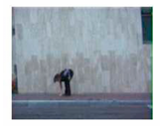

Paper 3
Introduction
Recognizing human actions with multiple Fourier transforms [10]
In this section, we'll explore an innovative approach for action recognition using Fourier transforms and shape descriptors, as presented in a paper by Katarzyna Gościewska and Dariusz Frejlichowski in 2020

Slide 62
Paper 3
Method
Recognizing human actions with multiple Fourier transforms
This paper takes a data-centric approach to action recognition, focusing on classifying video sequences based on action representations derived through shape descriptors.

Slide 63
Paper 3
Method
Recognizing human actions with multiple Fourier transforms
This paper takes a data-centric approach to action recognition, focusing on classifying video sequences based on action representations derived through shape descriptors.
It begins by analyzing each sequence of binary silhouettes to extract shape descriptors, which are then compared with those of the first frame to create vectors of similarities or dissimilarities.
Frame of the bending action [12]
Bending foreground masks (Represented by descriptor) [12]

Slide 64
Paper 3
Method
Recognizing human actions with multiple Fourier transforms
This paper takes a data-centric approach to action recognition, focusing on classifying video sequences based on action representations derived through shape descriptors.
It begins by analyzing each sequence of binary silhouettes to extract shape descriptors, which are then compared with those of the first frame to create vectors of similarities or dissimilarities.
These vectors are then transformed into action representations using the discrete Fourier transform (DFT), power spectral density estimate, or a combination of both.

Slide 65
Paper 3
Method
Recognizing human actions with multiple Fourier transforms
This paper takes a data-centric approach to action recognition, focusing on classifying video sequences based on action representations derived through shape descriptors.
It begins by analyzing each sequence of binary silhouettes to extract shape descriptors, which are then compared with those of the first frame to create vectors of similarities or dissimilarities.
These vectors are then transformed into action representations using the discrete Fourier transform (DFT), power spectral density estimate, or a combination of both.
Classification is carried out through leave-one-out cross-validation, supported by various matching measures.

Slide 66
Paper 3
Application
Recognizing human actions with multiple Fourier transforms
Binary silhouette shape descriptor vectors are transformed into action representations using the discrete Fourier transform (DFT).

Slide 67
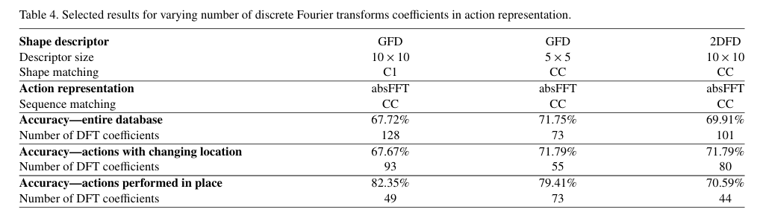
Paper 3
Key-Findings
Recognizing human actions with multiple Fourier transforms
[12]

Slide 68
Paper 3
Key-Findings
Recognizing human actions with multiple Fourier transforms
[12]
The best combination achieved an accuracy of 71.75% for the entire database, featuring 5x5 GFD for shape description, 73 DFT coefficients for action representation, and the C1 correlation for matching [10].

Slide 69
Paper 3
Key-Findings
Recognizing human actions with multiple Fourier transforms
[12]
The best combination achieved an accuracy of 71.75% for the entire database, featuring 5x5 GFD for shape description, 73 DFT coefficients for action representation, and the C1 correlation for matching.
For actions with changing locations, the highest accuracy reached 71.79% using the same combination but with 55 DFT coefficients [10].

Slide 70
Paper 3
Key-Findings
Recognizing human actions with multiple Fourier transforms
[12]
The best combination achieved an accuracy of 71.75% for the entire database, featuring 5x5 GFD for shape description, 73 DFT coefficients for action representation, and the C1 correlation for matching.
For actions with changing locations, the highest accuracy reached 71.79% using the same combination but with 55 DFT coefficients.
Actions performed in place achieved an impressive accuracy of 82.35% with a combination of 10x10 GFD matched by C1 correlation and 49 DFT coefficients for action representation [10].

Slide 71
Paper 3
Advantages
Fourier analysis using the number of COVID-19 daily deaths in the US
Versatility through the combination of different shape descriptors, Fourier transforms, and matching measures, making it adaptable to various applications of action recognition.

Slide 72
Paper 3
Advantages
Fourier analysis using the number of COVID-19 daily deaths in the US
Versatility through the combination of different shape descriptors, Fourier transforms, and matching measures, making it adaptable to various applications of action recognition.
Incorporation of both holistic and local features, enhancing recognition accuracy by capturing various aspects of actions.

Slide 73
Paper 3
Advantages
Fourier analysis using the number of COVID-19 daily deaths in the US
Versatility through the combination of different shape descriptors, Fourier transforms, and matching measures, making it adaptable to various applications of action recognition.
Incorporation of both holistic and local features, enhancing recognition accuracy by capturing various aspects of actions.
Effective use of Fourier transform-based features, offering a promising approach previously successful in object recognition and image retrieval.

Slide 74
Paper 3
Advantages
Fourier analysis using the number of COVID-19 daily deaths in the US
Versatility through the combination of different shape descriptors, Fourier transforms, and matching measures, making it adaptable to various applications of action recognition.
Incorporation of both holistic and local features, enhancing recognition accuracy by capturing various aspects of actions.
Effective use of Fourier transform-based features, offering a promising approach previously successful in object recognition and image retrieval.
Coarse classification, distinguishing between actions performed in place and actions with changing locations for refined recognition.

Slide 75
Paper 3
Advantages
Fourier analysis using the number of COVID-19 daily deaths in the US
Versatility through the combination of different shape descriptors, Fourier transforms, and matching measures, makes it adaptable to various applications of action recognition.
Incorporation of both holistic and local features, enhancing recognition accuracy by capturing various aspects of actions.
Effective use of Fourier transform-based features, offering a promising approach previously successful in object recognition and image retrieval.
Coarse classification, distinguishing between actions performed in place and actions with changing locations for refined recognition.
Extensive experimental investigation, offering valuable insights for action recognition tasks.

Slide 76
Paper 3
Disadvantages
Fourier analysis using the number of COVID-19 daily deaths in the US
Complexity, as the approach combines various methods and algorithms, which may impact real-time applications or require significant computational resources.

Slide 77
Paper 3
Disadvantages
Fourier analysis using the number of COVID-19 daily deaths in the US
Complexity, as the approach combines various methods and algorithms, which may impact real-time applications or require significant computational resources.
Database specificity, as experiments are conducted using the Weizmann database. The approach's effectiveness in other real-world scenarios or with larger and more diverse datasets requires further validation.

Slide 78
Paper 3
Disadvantages
Fourier analysis using the number of COVID-19 daily deaths in the US
Complexity, as the approach combines various methods and algorithms, which may impact real-time applications or require significant computational resources.
Database specificity, as experiments are conducted using the Weizmann database. The approach's effectiveness in other real-world scenarios or with larger and more diverse datasets requires further validation.
Parameter tuning challenges, including the number of Fourier coefficients and descriptor size, which may impact results in specific applications.

Slide 79
Paper 3
Disadvantages
Fourier analysis using the number of COVID-19 daily deaths in the US
Complexity, as the approach combines various methods and algorithms, which may impact real-time applications or require significant computational resources.
Database specificity, as experiments are conducted using the Weizmann database. The approach's effectiveness in other real-world scenarios or with larger and more diverse datasets requires further validation.
Parameter tuning challenges, including the number of Fourier coefficients and descriptor size, which may impact results in specific applications.
Recognition limitations, particularly for complex actions or activities involving multiple objects and interactions, which may require additional techniques.

Slide 80
Paper 3
Disadvantages
Fourier analysis using the number of COVID-19 daily deaths in the US
Complexity, as the approach combines various methods and algorithms, which may impact real-time applications or require significant computational resources.
Database specificity, as experiments are conducted using the Weizmann database. The approach's effectiveness in other real-world scenarios or with larger and more diverse datasets requires further validation.
Parameter tuning challenges, including the number of Fourier coefficients and descriptor size, which may impact results in specific applications.
Recognition limitations, particularly for complex actions or activities involving multiple objects and interactions, which may require additional techniques.
The need for further research and development for practical implementation and adaptation to real-world applications, such as surveillance or human-computer interaction.

Slide 81
Paper 4
Introduction
Method
Application
Key-findings
Advantages and Disadvantages

Slide 82
Paper 4
Introduction
Method
Application
Key-findings
Advantages and Disadvantages

Slide 83
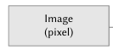
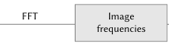
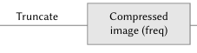
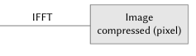
Paper 4
Introduction
Optimizing Fast Fourier Transform (FFT) Image Compression using Intelligent Water Drop (IWD) Algorithm [13]
This paper, published in 2022, introduces an innovative approach to image compression by combining the Fast Fourier Transform (FFT) with the Intelligent Water Drop (IWD) algorithm
Block diagram for image compression using Fast Fourier Transform [13]

Slide 84
Paper 4
Method
Optimizing Fast Fourier Transform (FFT) Image Compression using Intelligent Water Drop (IWD) Algorithm
This method focuses on adaptability and memory efficiency in image compression, addressing the ever-growing demand for efficient image applications.
Key steps in this method include:

Slide 85
Paper 4
Method
Optimizing Fast Fourier Transform (FFT) Image Compression using Intelligent Water Drop (IWD) Algorithm
This method focuses on adaptability and memory efficiency in image compression, addressing the ever-growing demand for efficient image applications.
Key steps in this method include:
Initiate the process by applying the Fast Fourier Transform (FFT) to the image.
Step 1

Slide 86
Paper 4
Method
Optimizing Fast Fourier Transform (FFT) Image Compression using Intelligent Water Drop (IWD) Algorithm
This method focuses on adaptability and memory efficiency in image compression, addressing the ever-growing demand for efficient image applications.
Key steps in this method include:
Initiate the process by applying the Fast Fourier Transform (FFT) to the image.
Next, truncate the frequency domain output based on calculated thresholds.
Step 1
Step 2

Slide 87
Paper 4
Method
Optimizing Fast Fourier Transform (FFT) Image Compression using Intelligent Water Drop (IWD) Algorithm
This method focuses on adaptability and memory efficiency in image compression, addressing the ever-growing demand for efficient image applications.
Key steps in this method include:
Initiate the process by applying the Fast Fourier Transform (FFT) to the image.
Next, truncate the frequency domain output based on calculated thresholds.
Finally, apply an inverse FFT (IFFT) to generate the compressed image.
Step 2
Step 3

Slide 88
Paper 4
Method
Optimizing Fast Fourier Transform (FFT) Image Compression using Intelligent Water Drop (IWD) Algorithm
This method focuses on adaptability and memory efficiency in image compression, addressing the ever-growing demand for efficient image applications.
Key steps in this method include:
Initiate the process by applying the Fast Fourier Transform (FFT) to the image.
Next, truncate the frequency domain output based on calculated thresholds.
Finally, apply an inverse FFT (IFFT) to generate the compressed image.
The primary objective is to generate a compact representation of the image, significantly reducing data storage, transmission, and processing requirements, all while preserving image quality.

Slide 89
Paper 4
Application
Optimizing Fast Fourier Transform (FFT) Image Compression using Intelligent Water Drop (IWD) Algorithm
The optimization of FFT threshold values by using the Intelligent Water Drop (IWD) algorithm, which ensures high compression rates without compromising image quality.

Slide 90
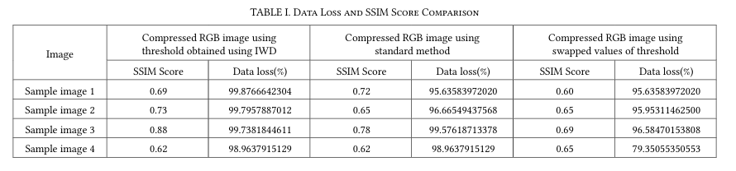
Paper 4
Key-Findings
Optimizing Fast Fourier Transform (FFT) Image Compression using Intelligent Water Drop (IWD) Algorithm
The paper presents results using SSIM (Structural Similarity) Index or scores and data loss percentages to assess IWD-based FFT compression method.
[13]

Slide 91
Paper 4
Key-Findings
Optimizing Fast Fourier Transform (FFT) Image Compression using Intelligent Water Drop (IWD) Algorithm
The paper presents results using SSIM (Structural Similarity) Index or scores and data loss percentages to assess IWD-based FFT compression method.
It also demonstrates the efficiency of IWD-based FFT compression for different sample images.
[13]

Slide 92
Paper 4
Key-Findings
Optimizing Fast Fourier Transform (FFT) Image Compression using Intelligent Water Drop (IWD) Algorithm
The paper presents results using SSIM (Structural Similarity) Index or scores and data loss percentages to assess IWD-based FFT compression method.
It also demonstrates the efficiency of IWD-based FFT compression for different sample images.
Sample image 1:
Predefined thresholds: 95% data loss, SSIM score 0.72.
IWD-derived thresholds: 99.8% data loss, SSIM score 0.69.
[13]

Slide 93
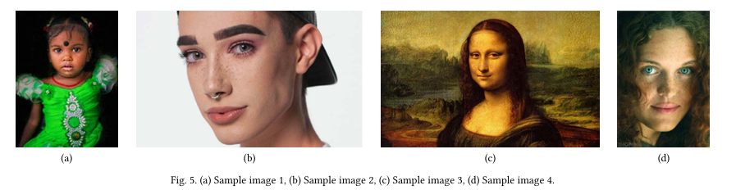
Paper 4
Key-Findings
Optimizing Fast Fourier Transform (FFT) Image Compression using Intelligent Water Drop (IWD) Algorithm
[13]

Slide 94
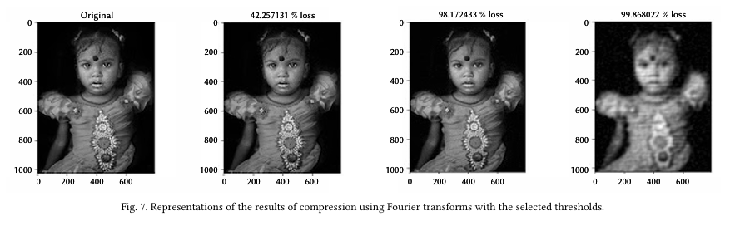
Paper 4
Key-Findings
Optimizing Fast Fourier Transform (FFT) Image Compression using Intelligent Water Drop (IWD) Algorithm
Sample image 1:
Predefined thresholds: 95% data loss, SSIM score 0.72.
IWD-derived thresholds: 99.8% data loss, SSIM score 0.69.
[13]

Slide 95
Paper 4
Advantages
Optimizing Fast Fourier Transform (FFT) Image Compression using Intelligent Water Drop (IWD) Algorithm
Improved Compression Quality: It optimizes FFT thresholds with the IWD algorithm, maintaining higher image quality even after significant compression, making it ideal for applications where image quality is paramount.

Slide 96
Paper 4
Advantages
Optimizing Fast Fourier Transform (FFT) Image Compression using Intelligent Water Drop (IWD) Algorithm
Improved Compression Quality: It optimizes FFT thresholds with the IWD algorithm, maintaining higher image quality even after significant compression, making it ideal for applications where image quality is paramount.
Adaptability: The approach tailors threshold values for each image, enhancing compression efficiency while preserving image quality, thanks to its adaptability.

Slide 97
Paper 4
Advantages
Optimizing Fast Fourier Transform (FFT) Image Compression using Intelligent Water Drop (IWD) Algorithm
Improved Compression Quality: It optimizes FFT thresholds with the IWD algorithm, maintaining higher image quality even after significant compression, making it ideal for applications where image quality is paramount.
Adaptability: The approach tailors threshold values for each image, enhancing compression efficiency while preserving image quality, thanks to its adaptability.
Efficient Memory Utilization: It significantly reduces memory requirements for image storage, transmission, and processing, addressing the needs of applications with limited storage or bandwidth.

Slide 98
Paper 4
Advantages
Optimizing Fast Fourier Transform (FFT) Image Compression using Intelligent Water Drop (IWD) Algorithm
Improved Compression Quality: It optimizes FFT thresholds with the IWD algorithm, maintaining higher image quality even after significant compression, making it ideal for applications where image quality is paramount.
Adaptability: The approach tailors threshold values for each image, enhancing compression efficiency while preserving image quality, thanks to its adaptability.
Efficient Memory Utilization: It significantly reduces memory requirements for image storage, transmission, and processing, addressing the needs of applications with limited storage or bandwidth.
Versatility: The use of the IWD algorithm in image compression highlights the versatility of this optimization technique.

Slide 99
Paper 4
Disadvantages
Optimizing Fast Fourier Transform (FFT) Image Compression using Intelligent Water Drop (IWD) Algorithm
Computational Intensity: Optimizing threshold values for each image through the IWD algorithm can be computationally demanding, potentially increasing the time required for compression.

Slide 100
Paper 4
Disadvantages
Optimizing Fast Fourier Transform (FFT) Image Compression using Intelligent Water Drop (IWD) Algorithm
Computational Intensity: Optimizing threshold values for each image through the IWD algorithm can be computationally demanding, potentially increasing the time required for compression.
Complex Parameter Space: Managing a parameter space that caters to the unique characteristics of various images can be challenging, as discussed in the paper.

Slide 101
Paper 4
Disadvantages
Optimizing Fast Fourier Transform (FFT) Image Compression using Intelligent Water Drop (IWD) Algorithm
Computational Intensity: Optimizing threshold values for each image through the IWD algorithm can be computationally demanding, potentially increasing the time required for compression.
Complex Parameter Space: Managing a parameter space that caters to the unique characteristics of various images can be challenging, as discussed in the paper.
Experimental Complexity: Implementing the method introduces additional complexity to the image compression process, necessitating a deep understanding of the IWD algorithm and its applications.

Slide 102
Paper 4
Disadvantages
Optimizing Fast Fourier Transform (FFT) Image Compression using Intelligent Water Drop (IWD) Algorithm
Computational Intensity: Optimizing threshold values for each image through the IWD algorithm can be computationally demanding, potentially increasing the time required for compression.
Complex Parameter Space: Managing a parameter space that caters to the unique characteristics of various images can be challenging, as discussed in the paper.
Experimental Complexity: Implementing the method introduces additional complexity to the image compression process, necessitating a deep understanding of the IWD algorithm and its applications.
Need for Further Research: Further exploration is required to assess the effectiveness of a larger parameter space for threshold value optimization, as indicated in the paper.

Slide 103
Paper 5
Introduction
Method
Application
Key-findings
Advantages and Disadvantages

Slide 104
Paper 5
Introduction
Method
Application
Key-findings
Advantages and Disadvantages

Slide 105
Paper 5
Introduction
Discrete Fourier Transform (DFT)-Based Computational Intelligence Model for Urban Carbon Emission and Economic Growth [14]
Now, we will delve into the comprehensive analysis of urban economic growth and carbon emission modeling, focusing on a research paper from the year 2022 authored by Chun Fu, Xiayun Gui, and Farzana Akter.

Slide 106
Paper 5
Method
Discrete Fourier Transform (DFT)-Based Computational Intelligence Model for Urban Carbon Emission and Economic Growth
The study adopts a robust data-centric approach, placing empirical data at its core. It employs the Fourier transform method to extract essential periodic signals from datasets, providing the basis for constructing models.

Slide 107
Paper 5
Method
Discrete Fourier Transform (DFT)-Based Computational Intelligence Model for Urban Carbon Emission and Economic Growth
The study adopts a robust data-centric approach, placing empirical data at its core. It employs the Fourier transform method to extract essential periodic signals from datasets, providing the basis for constructing models.
Notably, the economic growth model integrates real-world data on energy consumption and carbon emissions. The data highlights a significant surge in total energy utilization over the past decade, specifically quantifying carbon emissions per unit of GDP and emphasizing the growing environmental-economic contradiction.

Slide 108
Paper 5
Application
Discrete Fourier Transform (DFT)-Based Computational Intelligence Model for Urban Carbon Emission and Economic Growth
Fourier transform method to extract essential periodic signals from datasets

Slide 109
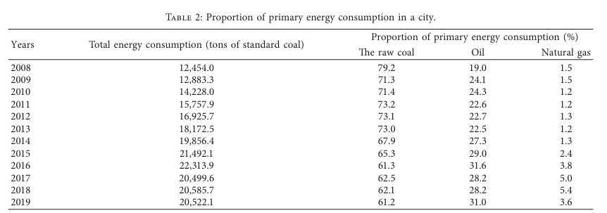
Paper 5
Key-Findings
Discrete Fourier Transform (DFT)-Based Computational Intelligence Model for Urban Carbon Emission and Economic Growth
Data from Nanchang, a specific region of focus, uncovers a substantial reliance on coal for economic development but also reveals a promising shift towards greener energy sources. The proportion of raw coal consumption dropped from 79.2% in 2008 to 61.2% in 2019.
[14]

Slide 110
Paper 5
Advantages
Discrete Fourier Transform (DFT)-Based Computational Intelligence Model for Urban Carbon Emission and Economic Growth
One of the key strengths of this paper lies in its extensive use of empirical data. The research is deeply rooted in real-world information, ensuring that the models are firmly grounded and evidence-based.

Slide 111
Paper 5
Advantages
Discrete Fourier Transform (DFT)-Based Computational Intelligence Model for Urban Carbon Emission and Economic Growth
One of the key strengths of this paper lies in its extensive use of empirical data. The research is deeply rooted in real-world information, ensuring that the models are firmly grounded and evidence-based.
Categorizing cities based on carbon emission efficiency and identifying the key factors influencing carbon emissions are all substantiated by concrete data.

Slide 112
Paper 5
Advantages
Discrete Fourier Transform (DFT)-Based Computational Intelligence Model for Urban Carbon Emission and Economic Growth
One of the key strengths of this paper lies in its extensive use of empirical data. The research is deeply rooted in real-world information, ensuring that the models are firmly grounded and evidence-based.
Categorizing cities based on carbon emission efficiency and identifying the key factors influencing carbon emissions are all substantiated by concrete data.
This data-driven approach bolsters the paper's credibility and practical applicability, offering valuable insights for policymakers and urban planners seeking sustainable development strategies.

Slide 113
Paper 5
Disadvantages
Discrete Fourier Transform (DFT)-Based Computational Intelligence Model for Urban Carbon Emission and Economic Growth
While this paper provides a robust analysis, it does have limitations. Firstly, its reliance on historical data may constrain its relevance in forecasting future trends.

Slide 114
Paper 5
Disadvantages
Discrete Fourier Transform (DFT)-Based Computational Intelligence Model for Urban Carbon Emission and Economic Growth
While this paper provides a robust analysis, it does have limitations. Firstly, its reliance on historical data may constrain its relevance in forecasting future trends.
The dynamism of economic and environmental conditions may not be entirely captured by the models, potentially overlooking emerging factors that could influence carbon emissions and economic growth.

Slide 115
Paper 5
Disadvantages
Discrete Fourier Transform (DFT)-Based Computational Intelligence Model for Urban Carbon Emission and Economic Growth
While this paper provides a robust analysis, it does have limitations. Firstly, its reliance on historical data may constrain its relevance in forecasting future trends.
The dynamism of economic and environmental conditions may not be entirely captured by the models, potentially overlooking emerging factors that could influence carbon emissions and economic growth.
Additionally, the paper's focus on a specific region, Nanchang, may limit the generalizability of its findings to other urban areas with distinct economic and environmental characteristics.

Slide 116
Paper 5
Disadvantages
Discrete Fourier Transform (DFT)-Based Computational Intelligence Model for Urban Carbon Emission and Economic Growth
While this paper provides a robust analysis, it does have limitations. Firstly, its reliance on historical data may constrain its relevance in forecasting future trends.
The dynamism of economic and environmental conditions may not be entirely captured by the models, potentially overlooking emerging factors that could influence carbon emissions and economic growth.
Additionally, the paper's focus on a specific region, Nanchang, may limit the generalizability of its findings to other urban areas with distinct economic and environmental characteristics.
Furthermore, it predominantly examines economic growth in terms of GDP, which may not fully encompass overall development and environmental sustainability.

Slide 117
03
Conclusion

Slide 118

Conclusions
Reviewing recent Fourier transform research has unveiled a wealth of discoveries across diverse domains. These papers introduced sFFT for image processing, applied Fourier analysis to pandemic monitoring, demonstrated Fourier's robustness in action recognition, integrated FFT with the IWD algorithm for efficient image compression, and utilized Fourier transforms for urban carbon emissions and economic growth modeling. Collectively, they showcase the versatility and potential of Fourier transforms in addressing computational challenges across various disciplines, underscoring its reliability and untapped possibilities for the future

Slide 119
04
Future Direction

Slide 120
Future Direction
In this section, I will be sharing what I think should be the future direction for all five papers.

Slide 121
Future Direction
In this section, I will be sharing what I think should be the future direction for all five papers.
Paper 1:
Explore advanced variations of sFFT for image processing.
Balance high accuracy with reduced computational complexity.

Slide 122
Future Direction
In this section, I will be sharing what I think should be the future direction for all five papers.
Paper 2:
Develop predictive modeling and real-time decision support systems.
Create advanced techniques for identifying pandemic cycle lengths and analyzing power spectra.

Slide 123
References
In this section, I will be sharing what I think should be the future direction for all five papers.
Paper 3:
Refine Fourier-based methods for complex action recognition.
Apply advancements in surveillance, robotics, entertainment, and healthcare.

Slide 124
Future Direction
In this section, I will be sharing what I think should be the future direction for all five papers.
Paper 4:
Optimize the IWD algorithm for diverse image compression scenarios.
Extend its reach for efficient and accessible compression techniques.

Slide 125
Future Direction
In this section, I will be sharing what I think should be the future direction for all five papers.
Paper 5:
Expand research in urban development and sustainability, covering more cities and regions.
Utilize a broader set of indicators for comprehensive assessments.
Develop data-driven models and decision-support tools for urban planning.

Slide 126
05
References

Slide 127
References
[1] C. Abad-Zapatero, “Notes of a protein crystallographer: The legacy of J.-B. J. fourier – crystallography, time and beyond,” Acta Crystallographica Section D Structural Biology, vol. 77, no. 5, pp. 703–711, 2021. doi:10.1107/s205979832100293x.
[2] J.-B. J. Fourier, “University of Notre Dame,” The analytical theory of heat, https://www3.nd.edu/~powers/ame.20231/fourier1878.pdf (accessed Oct. 27, 2023).
[3] “Joseph Fourier,” Wikipedia, https://en.wikipedia.org/wiki/Joseph_Fourier (accessed Oct. 30, 2023).
[4] K. Gayan et al., Fast-Fourier-Transformation-2-Fast-Fourier-Transformation-To-increase-the-performance, https://www.researchgate.net/figure/Fast-Fourier-Transformation-2-Fast-Fourier-Transformation-To-increase-the-performance_fig6_323281289 (accessed Oct. 30, 2023).
[5] “Fourier series,” Math is Fun Advanced, https://www.mathsisfun.com/calculus/fourier-series.html (accessed Oct. 30, 2023).
[6] “‘if you want to find the secrets of the universe, think in terms of energy, frequency and vibration.’- Nikola Tesla [736×736],” Reddit, https://www.reddit.com/r/QuotesPorn/comments/oy6qf2/if_you_want_to_find_the_secrets_of_the_universe/?rdt=37958 (accessed Oct. 30, 2023).
[7] Hardik, “Fourier transformation in image processing,” Medium, https://medium.com/crossml/fourier-transformation-in-image-processing-84142263d734 (accessed Oct. 30, 2023).
[8] “Home en,” FFT, https://www.nti-audio.com/en/support/know-how/fast-fourier-transform-fft (accessed Oct. 30, 2023).
[9] “Fourier Transform Spectrometer (FTS),” Life Science Trace Detection Laboratory, https://www.ru.nl/tdlab/research/laser_spectroscopy/fourier-transform-spectrometer-fts/ (accessed Oct. 30, 2023).
[10] H. A. Ghani, M. R. Abdul Malek, M. F. Kamarul Azmi, M. J. Muril, and A. Azizan, “A review on sparse fast fourier transform applications in image processing,” International Journal of Electrical and Computer Engineering (IJECE), vol. 10, no. 2, p. 1346, Apr. 2020. doi:10.11591/ijece.v10i2.pp1346-1351.
[11] Y. Takefuji, “Fourier analysis using the number of COVID-19 daily deaths in the US,” Epidemiology and Infection, vol. 149, 2021. doi:10.1017/s0950268821000522.
[12] K. Gościewska and D. Frejlichowski, “Recognizing human actions with multiple Fourier transforms,” Procedia Computer Science, vol. 176, pp. 1083–1090, 2020. doi:10.1016/j.procs.2020.09.104
[13] S. Kaur et al., “Optimizing Fast Fourier transform (FFT) image compression using intelligent water drop (IWD) algorithm,” International Journal of Interactive Multimedia and Artificial Intelligence, vol. 7, no. 7, p. 48, Jan. 2022. doi:10.9781/ijimai.2022.01.004
[14] C. Fu, X. Gui, and F. Akter, “Discrete fourier transform (dft)-based computational intelligence model for urban carbon emission and economic growth,” Mathematical Problems in Engineering, vol. 2022, pp. 1–10, Feb. 2022. doi:10.1155/2022/4225080

Slide 128
Thanks
Do you have any questions?

